Slide 1
Multi-Patch Geometries

Slide 2
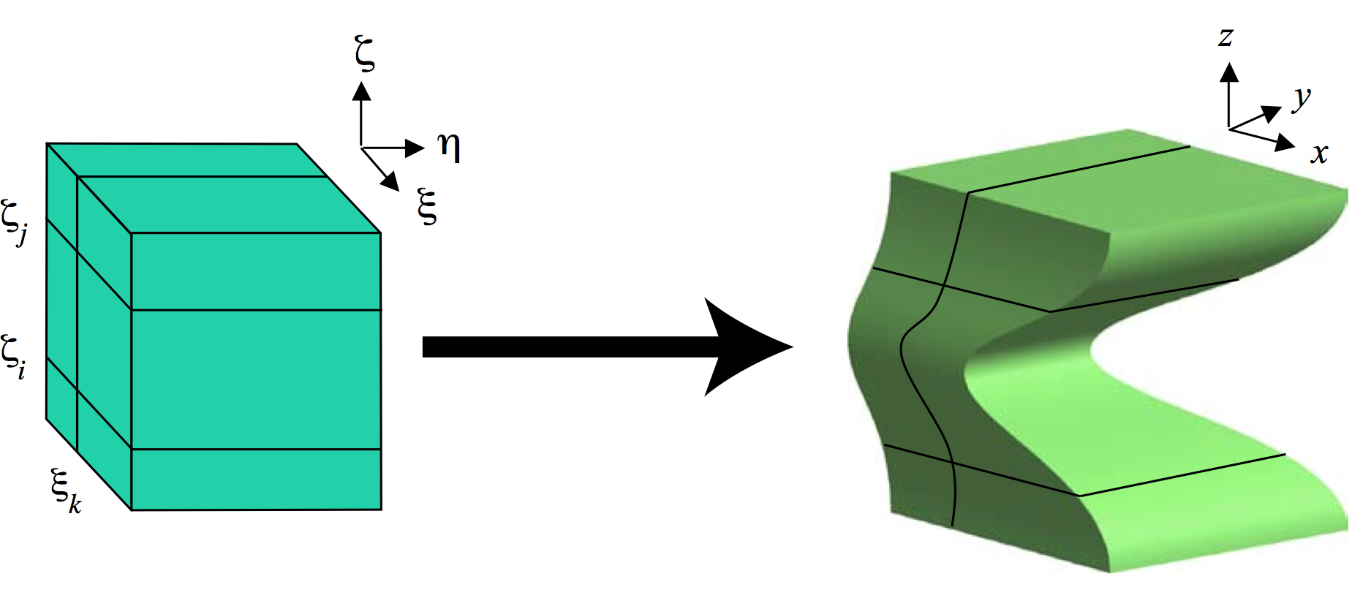
V (ξ)

Slide 3
V (ξ)
This is referred to as a single patch geometry, as the
geometry is composed using a single NURBS map.

Slide 4
V (ξ)
The single NURBS map takes the patch from parametric
space to physical space.

Slide 5
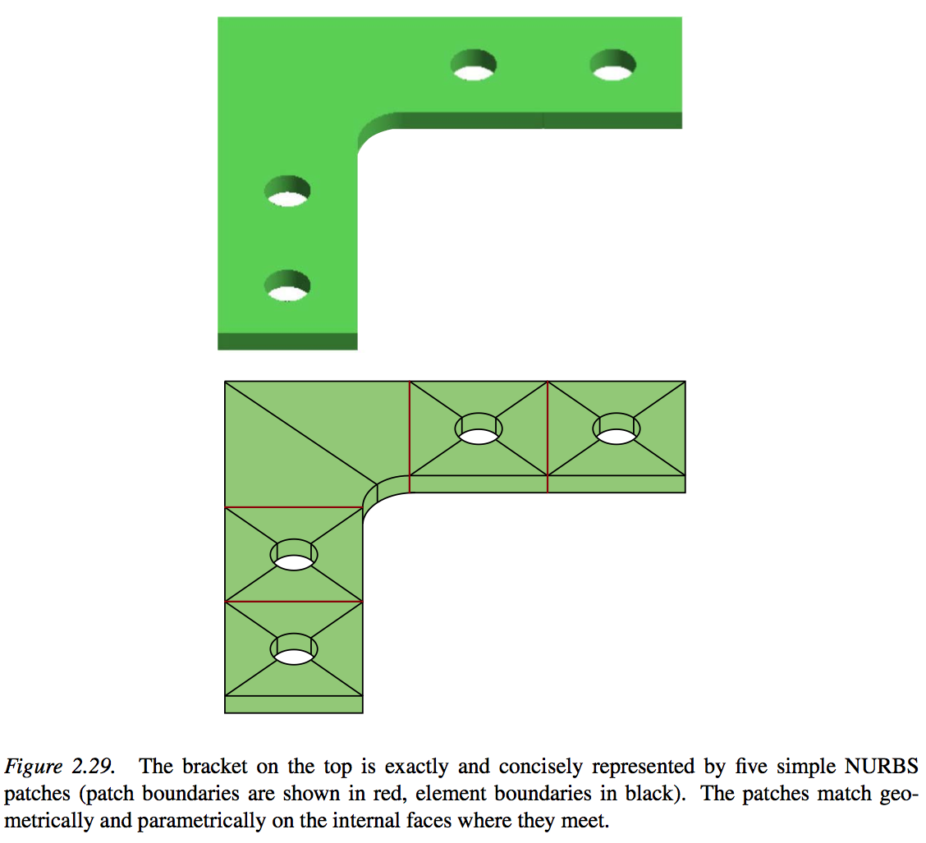
For this configuration, it is impossible to use a single NURBS map to parameterize the geometry. Instead, we use multiple patches.

Slide 7
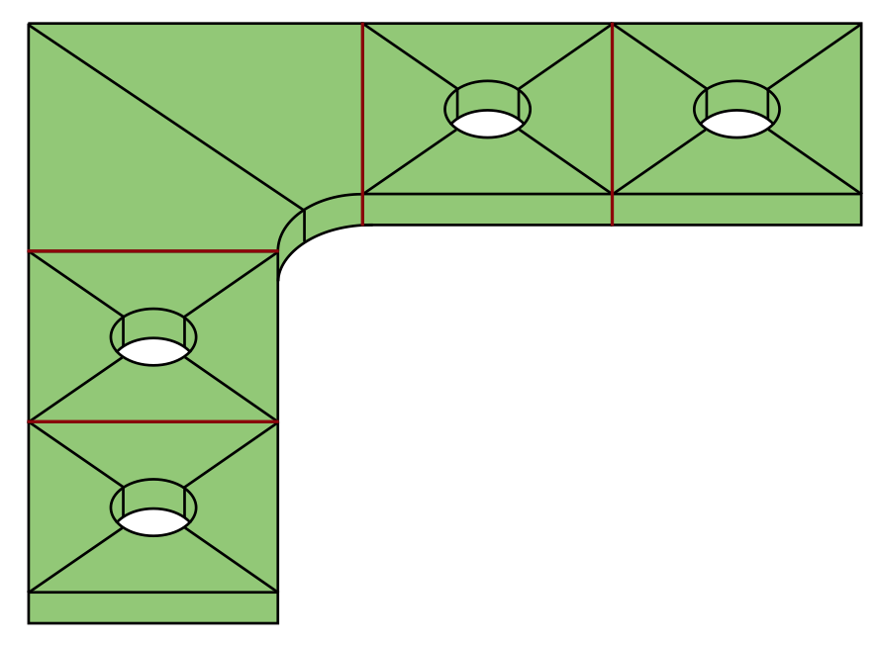
For each patch in physical space, there is a corresponding patch
in parametric space. A single NURBS mapping then takes the
patch back and forth from parametric space to physical space.

Slide 8
V_{q}(ξ)
V_{p}(ξ)
ξ₃
ξ₃
ξ₂
ξ₁
ξ₂
ξ₁

Slide 9
To ensure a watertight geometry, we must ensure that the patches
meet parametrically and geometrically on the internal faces where
they meet.

Slide 10
To ensure a watertight geometry, we must ensure that the patches
meet parametrically and geometrically on the internal faces where
they meet.
This requires that the control nets on opposing faces are coincident.

Slide 11
All of the aforementioned machinery may be extended to the multi-
patch setting. In fact, the element extraction operators are
unchanged.

Slide 12
All of the aforementioned machinery may be extended to the multi-
patch setting. In fact, the element extraction operators are
unchanged.
The patch-wise IEN arrays are modified using a master-slave relationship at the patch interfaces. See notes for more details.

Slide 13
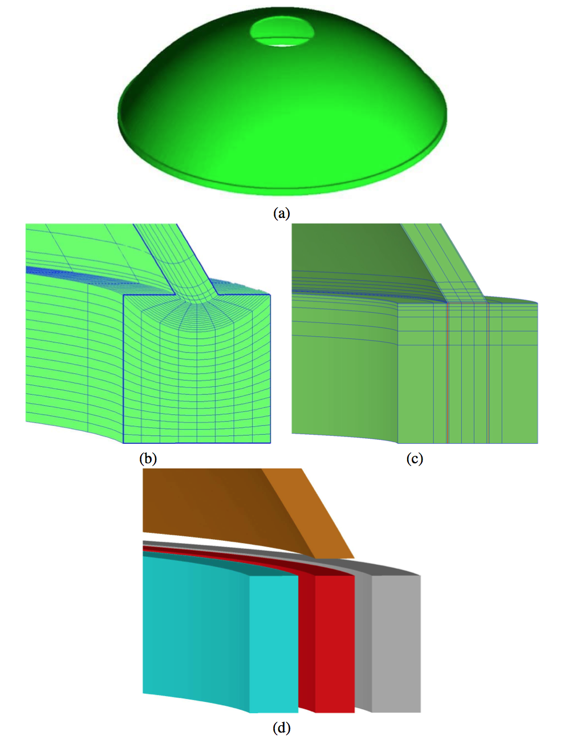
Single Patch Geometry
Multi-Patch Geometry

